Slide 1

Motivation
ORGB1500 - Organizational Behaviour for Media and IT - Ed Beerwart

Slide 2

Motivation
Content
Need vs. Wants
Pleasure/Unpleasure
Satisfaction of Instincts
Motivation
conscious/unconscious
primary/secondary
internal/external
Maslow’s Hierarchy of Needs
Alderfer’s ERG Theory
McClelland’s Learned Needs Theory

Slide 3
Needs vs. Wants

Slide 4
Need
R
U
“
A condition of tension in an organism resulting from deprivation of something required for survival, well-being, or personal fulfillment.
”
VandenBos, G. R. (Ed.). (2007). APA Dictionary of Psychology. Washington, DC, US: American Psychological Association.

Slide 5
Want
R
U
“
A longing or craving, as for something that brings satisfaction or enjoyment.
”
VandenBos, G. R. (Ed.). (2007). APA Dictionary of Psychology. Washington, DC, US: American Psychological Association.

Slide 6
Pleasure, Unpleasure and the
Satisfaction of Instincts

Slide 7
Pleasure
R
U
“
The emotion or sensation induced by the enjoyment or anticipation of what is felt or viewed as good or desirable.
”
VandenBos, G. R. (Ed.). (2007). APA Dictionary of Psychology. Washington, DC, US: American Psychological Association.

Slide 8
Unpleasure
R
U
“
In psychoanalytic theory, the psychic pain, tension, and ego suffering that is consciously felt when instinctual needs and wishes, such as hunger and sex, are blocked by the ego and denied gratification at a conscious, preconscious, or unconscious level.
”
VandenBos, G. R. (Ed.). (2007). APA Dictionary of Psychology. Washington, DC, US: American Psychological Association.

Slide 9
Satisfaction of Instincts
R
U
“
In psychoanalytic theory, the gratification of basic needs, such as hunger, thirst, sex, and aggression, which discharges tension, eliminates unpleasure, and restores the organism to a balanced state. Satisfaction may occur on a conscious preconscious, or unconscious level.
”
VandenBos, G. R. (Ed.). (2007). APA Dictionary of Psychology. Washington, DC, US: American Psychological Association.

Slide 10
Motivation

Slide 11
Motivation
R
U
The impetus that gives purpose or direction to human or animal behaviour and operates at a conscious or unconscious level.
Motives are frequently divided into (a) physiological, primary, or organic motives, such as hunger, thirst, and need for sleep, and (b) personal, social, or secondary motives, such as affiliation, competition, and individual interests and goals.
An important distinction must also be drawn between internal motivating forces and external factors, such as rewards or punishments that can encourage or discourage certain behaviours.
“
”
VandenBos, G. R. (Ed.). (2007). APA Dictionary of Psychology. Washington, DC, US: American Psychological Association.

Slide 12
Maslow’s Hierarchy of Needs

Slide 13
Maslow’s Hierarchy of Needs
R
U
“
The hierarchy of human motives, or needs, as described by humanist Abraham Maslow, which he developed as a reaction against the determinism of the theories of Sigmund Freud and B. F. Skinner.
Physiological needs (air, water, food, sleep, sex, etc.) are at the base; followed by safety and security (the safety needs); then love, affection, and gregariousness (the love needs); the prestige, competence, and power (the esteem needs); and, at the highest level, aesthetic needs, the need for knowing, and self-actualization (the metaneeds).
”
VandenBos, G. R. (Ed.). (2007). APA Dictionary of Psychology. Washington, DC, US: American Psychological Association.

Slide 14
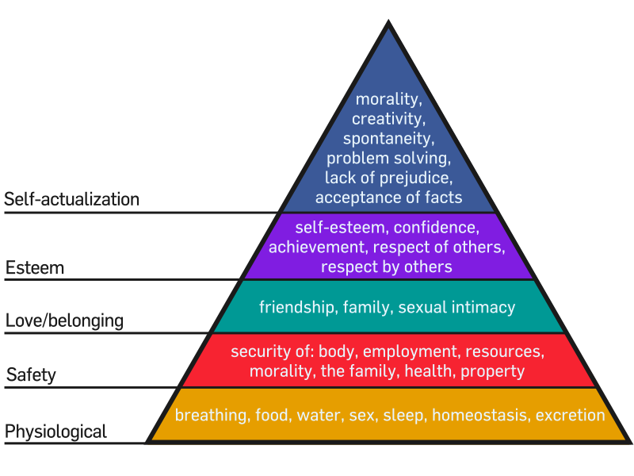
Maslow’s Hierarchy of Needs

Slide 15
Alderfer’s ERG Theory

Slide 16
Alderfer’s ERG Theory
R
U
“
Categorized the lower order needs (Physiological and Safety) into the Existence category.
Fit Maslow's interpersonal love and esteem needs into the Relatedness category.
The Growth category contained the self-actualization and self-esteem needs.
Proposed a satisfaction-progression/frustration-regression theory to go along with the ERG theory.
Stated that when needs in a higher category are not met then individuals redouble the efforts invested in a lower category need (frustration-regression).
For example, if self-actualization or self-esteem is not met then individuals will invest more effort in the relatedness category in the hopes of achieving the higher need.
”
Source : Alderfer, Clayton P. (1969). "An empirical test of a new theory of human needs". Organizational Behavior and Human Performance. 4 (2): 142–75.

Slide 17
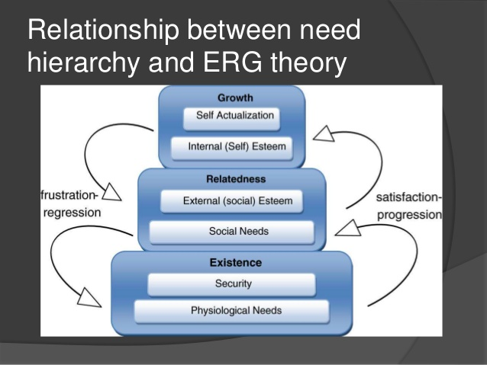
Alderfer’s ERG Theory
Source: https://www.slideshare.net/deathxer11/clayton-alderfers-erg-theory

Slide 18
McClelland’s Learned Needs Theory

Slide 19
McClelland’s Learned Needs Theory
R
U
“
“…psychologist David McClelland further investigated this idea [Maslow’s idea of individual characteristics influence the strength of higher order needs] that a person’s needs can be strengthened through reinforcement, learning, and social conditions.
McClelland examined three of these “learned” needs: achievement, power, and affiliation.”
”
Source: McShane, S. L., & Steen, S. L. (2009). Canadian Organizational Behaviour (7th ed., pp. 111). N.p.: McGraw-Hill Ryerson.

Slide 20
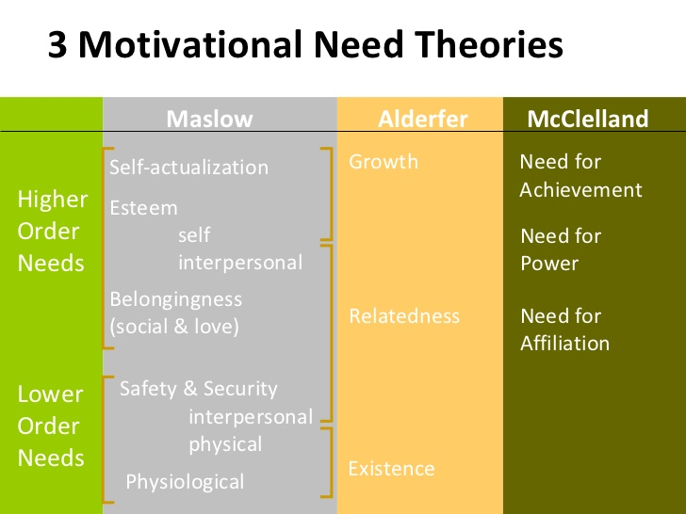
McClelland’s Learned Needs Theory

Slide 21

Thank You
ebeerwart@nait.ca

